Slide 1
Environmental Planning
Ph. D Research Proposal
Climate Change and the Role of Urban Greenspaces and its Planning:
The case of Addis Ababa
Candidate : Tekle Woldegerima
Supervisors: Dr. Kumlachew Yeshitela ( EiABC, AAU)
Dr. Sarah Lindley ( Manchester University)

Slide 2
Environmental Planning - Ph.D. Research Proposal
Statement of the Problem
The urban environment
  has distinctive biophysical features as compared to rural areas, its energy exchange is altered, induces an heat island, surface sealing changes in hydrological characteristics like increased surface runoff.
  has an impervious surface which absorb higher heat energy, ( the thermal properties of buildings, tar, asphalt, brick and concrete all with higher conductivity )
  These changes are partly due to reductions in urban greenspaces both in terms of area coverage, spatial distribution and vegetation composition which in turn affects the evaporative cooling,
  No sufficient research to investigate these issues and develop strategies particularly in cities of developing countries and almost no information exists for Addis Ababa

Slide 3
Environmental Planning - Ph.D. Research Proposal
Research Objectives
General:
Investigate the role of urban greenspaces in Climate change mitigation in the urban environments and the vulnerability of urban greenspaces to anthropogenic and human induced threats
Specific objectives :
Establish land cover types /characteristics of the urban environment in general and establish the temporal changes in the urban greenspaces
To analyze the carbon sequestration role by a selected category of an urban greenspaces of Addis Ababa and relate to its role in mitigating climate change impacts,

Slide 4
Environmental Planning - Ph.D. Research Proposal
Specific objectives :
Analyze the microclimate modification potential of urban greenspaces in Addis Ababa and establish its urban heat island mitigating role;
To analyze the major anthropogenic and none anthropogenic threats to urban greenspaces and the extent of vulnerability of the urban greenspaces of Addis Ababa,
Develop methodological recommendations towards the integration of urban greenspaces in urban development planning and implementation in the Addis Ababa city;

Slide 5
Environmental Planning - Ph.D. Research Proposal
Research Questions
This study will be conducted to address the following questions:
What is the extent, spatial pattern and the temporal changes in the urban land cover in general and the urban greenspaces in particular in the last three decades in Addis Ababa?
What is the carbon sequestration potential of the urban greenspaces in different categories of Addis Ababa City?
What is the capacity of urban green spaces of Addis Ababa in modifying local temperatures?
What are the major anthropogenic and none anthropogenic threats to the different categories of urban green spaces in Addis Ababa? and how vulnerable is the urban greenspace?

Slide 6
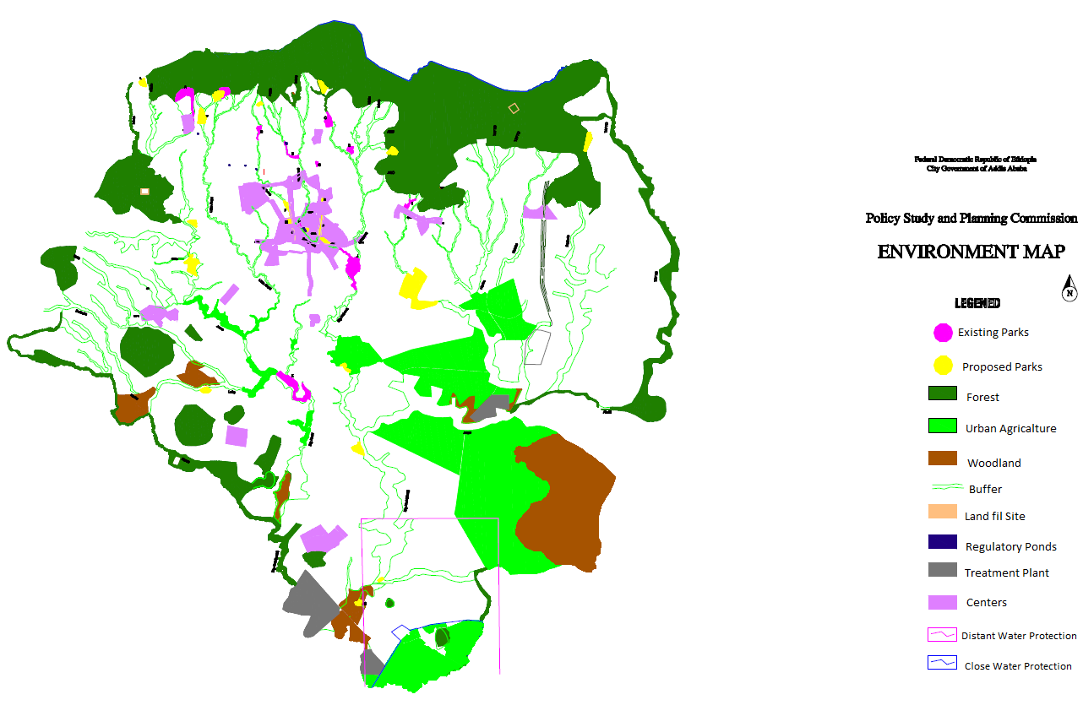
2. Methods and Materials
The Study Area
Addis Ababa City
Location
Latitude 8⁰57’0’’ to 9⁰04’0” N
Longitude 38⁰42’0” to 38⁰47’0” E
Average altitude 2650m asl
Population: 3,000,000
Land Area: 54,000ha
Greenspaces: 22 240 (41%)
  Which includes
  Forests
  River side forests
  Parks
  Urban agriculture
  Street tree

Slide 7
Summary of Methodology by Flow Chart
Spatial Data Base
GIS Analysis
Spatial Basis for stratified Sampling
Urban Morphology Types
Veg. Data
Temp. Monitoring
Threats on
UGS
Land Cover classes
Carbon Stock estimation
Compare and analyses
Factors analysis
Urban Green Space classes
Analysis of individual and combined effects
Change Analysis
Results, Discussion, Conclusion and Recommendations
The Role of Urban Greenspace in climate change and UHI Mitigation
Main Threats to Urban greenspaces identified and proposed Solutions
Methodologies for planning, monitoring and Management of UGS in Addis Ababa

Slide 8
Expected Research Outcomes
This research contributes to both the scientific literature advancement and urban greenspaces management.
Specific expected outcomes are:
Enriched literature on the urban morphology types and urban greenspaces under different climatic, socioeconomic setup and management conditions.
Established facts on the contribution of Addis Ababa urban greenspaces in mitigating urban climate change impacts through carbon sequestration and modifying the micro climate temperature ,
Major anthropogenic and none anthropogenic threats which affect the distribution and functions of the urban greenspaces in Addis Ababa are identified, analyzed and research based solutions recommended,
Methodologies for improving the planning, management and monitoring of urban greenspaces in Addis Ababa are developed and recommended ,

Slide 9
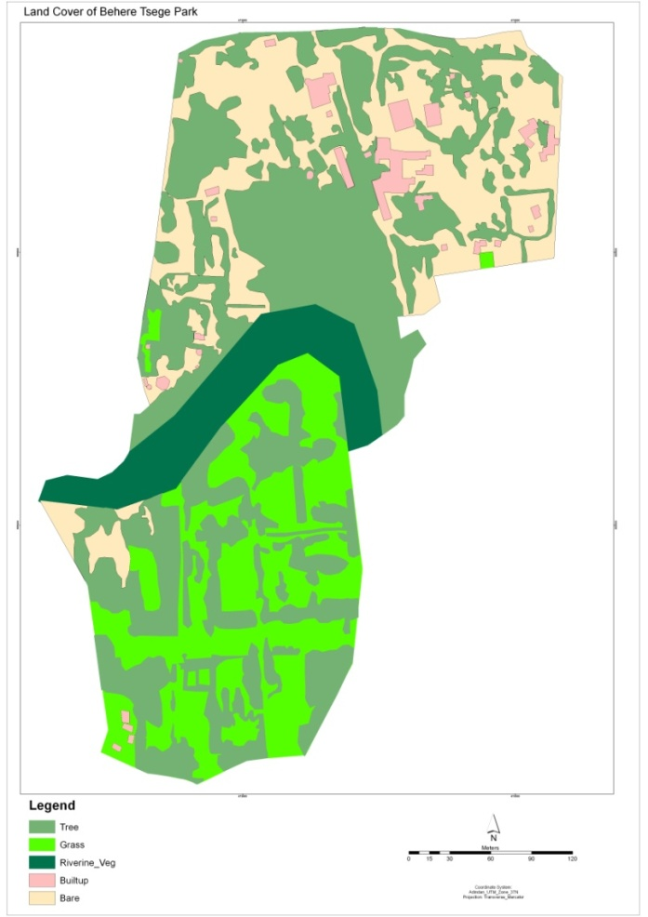
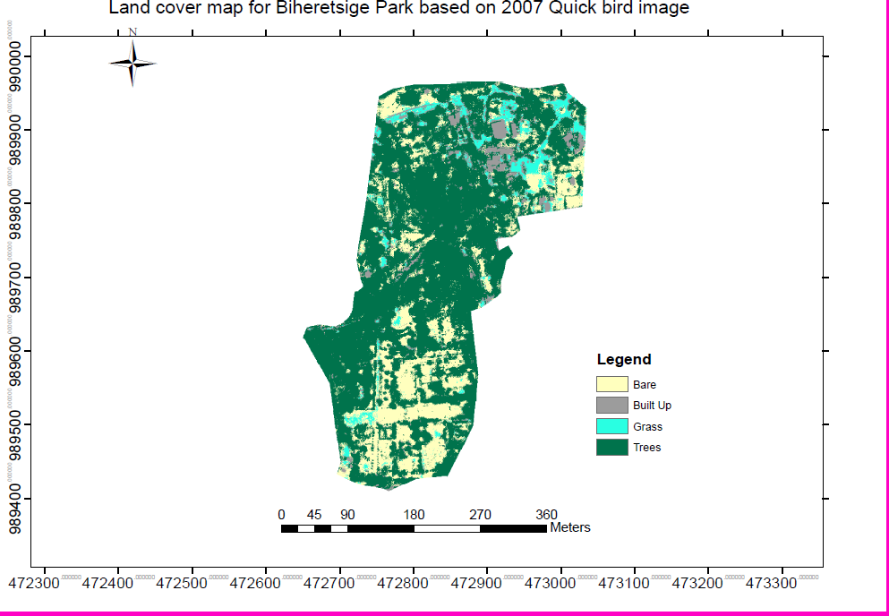
Land Cover Map for Bihere Tsige Park
BT_LC_OP_2007
BT_LC_QB_2007

Slide 10
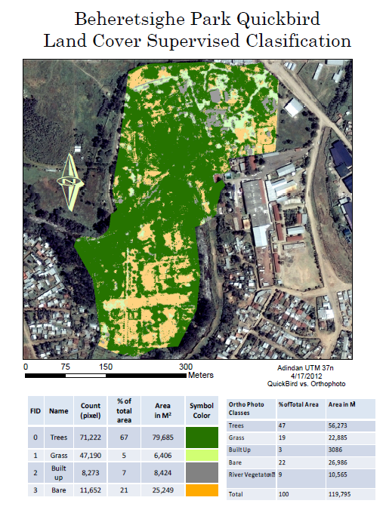
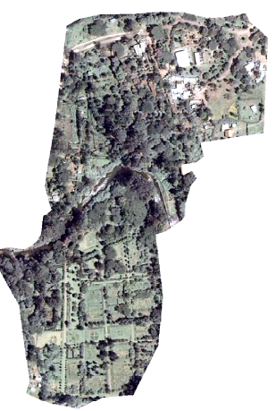
BT_QB_2007

Slide 12
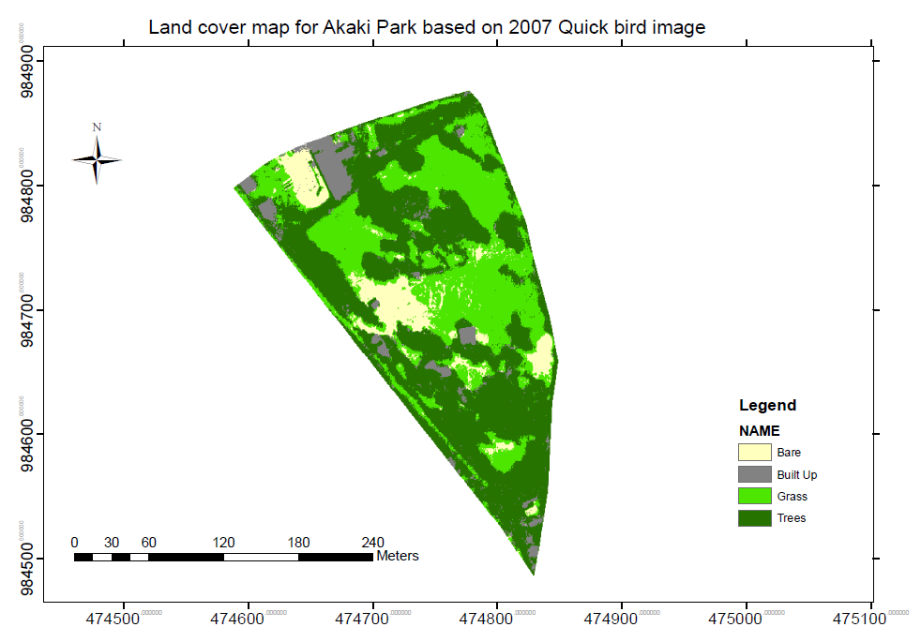
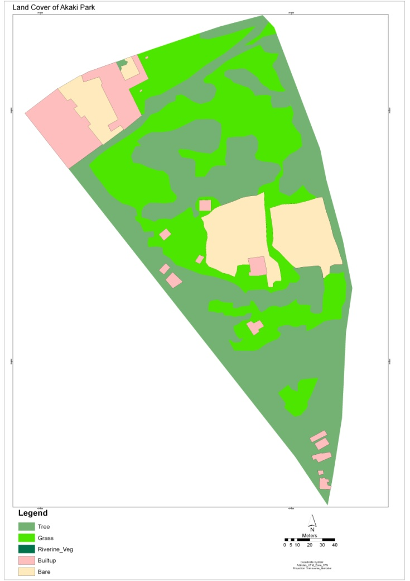
Land Cover Map for Akaki Park
AK_LC_OP_2007
AK_LC_QB_2007

Slide 13
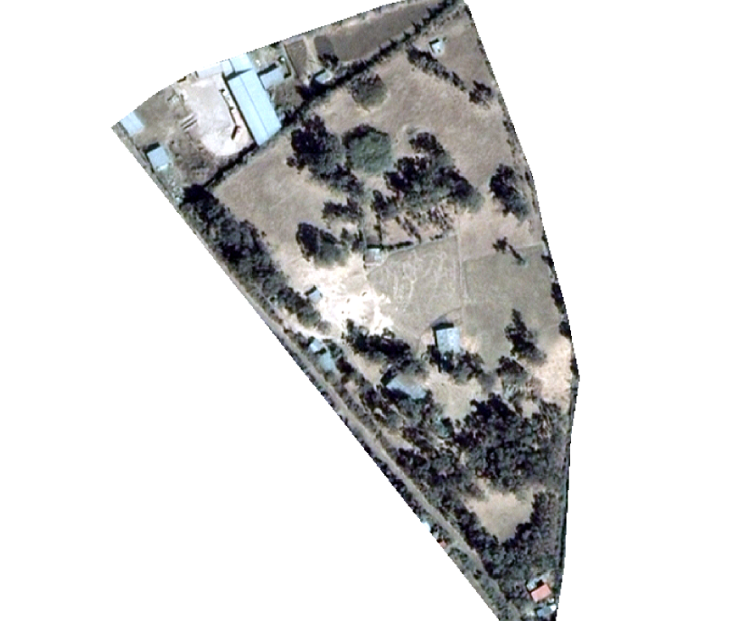
Land Cover Map for Akaki Park
AK_QB_2007
AK_LC_QB_2007

Slide 14
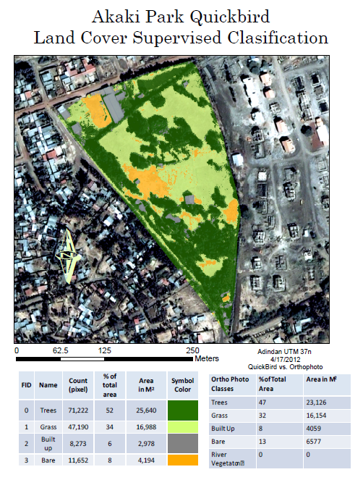

Slide 15
Work Plan
S.No. | Period of the year | Main Activity
1 | June - September 2011 | Research Proposal Development and submittal Consultation with Supervisors on the research Proposal Receive input from supervisors and peer group
2 | Oct - December 2011 | Attend Relevant Trainings ( GIS, Statistics etc) Work out the joint data collection strategy with the CLUVA research program Refining methodologies and data collection and analysis techniques
3 | Jan - December 2012 | Data Collection Data entry Data testing and verification
4 | Jan - December 2013 | Data Analysis Data processing Draft dissertation Writing
5 | Jan - December 2014 | Final dissertation Writing Submittal, Presentation and defending

Slide 16
Assistance needed
Material and methodology for Temperature Data recording comparing the cooling effect of green structures in the urban areas

Slide 17
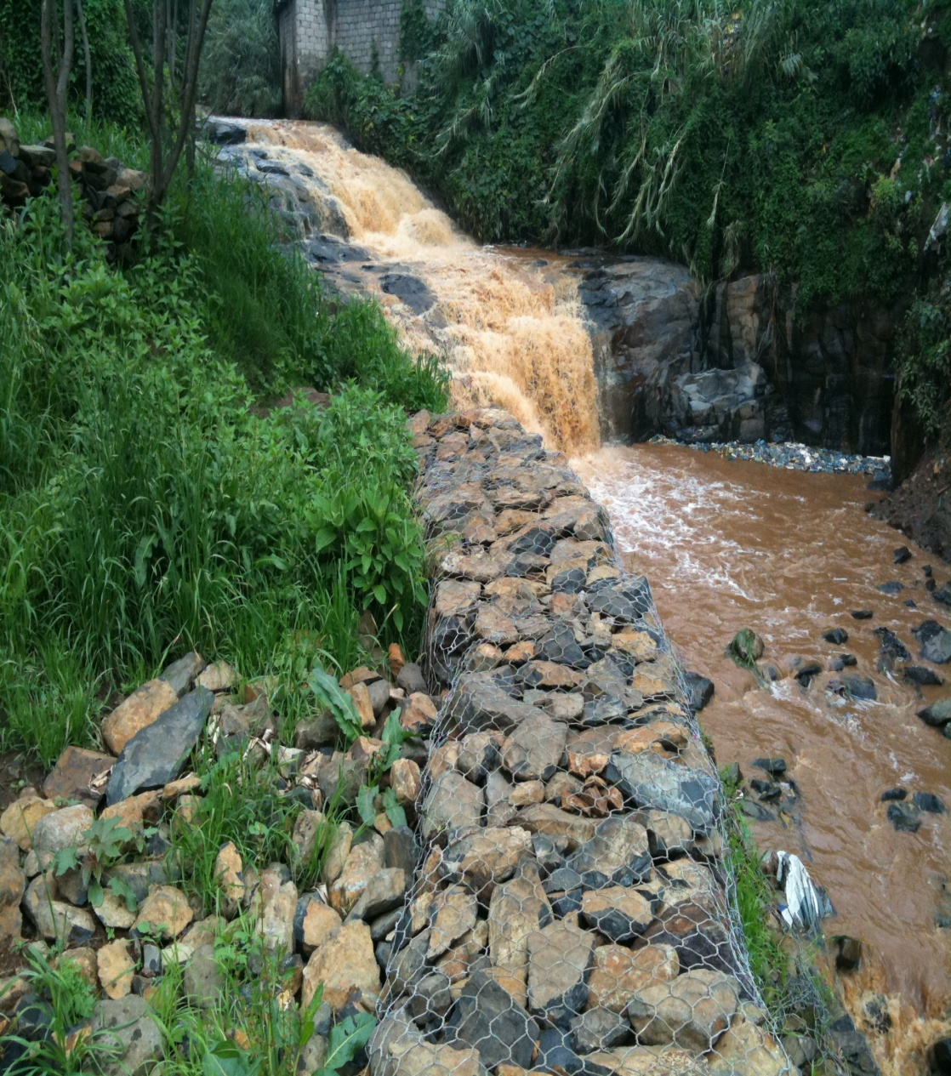
  Thank you for Your Attention

